Slide 1
Haar Cascade Face Detecting Classifier
Block Diagram

Slide 2
Introduction
The Haar Cascade Face Detecting Classifier is a popular method for detecting faces in images.
It involves several key stages in the process, and it produces a binary output, indicating whether a face was detected or not.

Slide 3
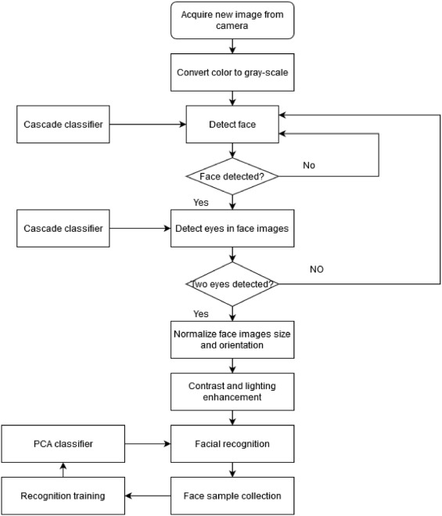
Diagram of Haar Cascade Face Detecting Classifier

Slide 4
Hardware Developing

Slide 5
Hardware Developing
The Haar Cascade Face Detecting Classifier has two parts of HW developing in this project
1) Computer-Based SETUP
2) Embedded System SETUP

Slide 6
Computer-Based SETUP
Computer: You'll need a computer with sufficient processing power. A multi-core CPU is recommended for real-time face detection.
Camera: Connect a camera to the computer. This can be an integrated webcam, an external USB camera, or a specialized camera for your application.
Monitor: A monitor displays the video feed from the camera and the real-time results of the face detection algorithm.
Power Supply: Ensure the computer is connected to a power source for continuous operation.

Slide 7
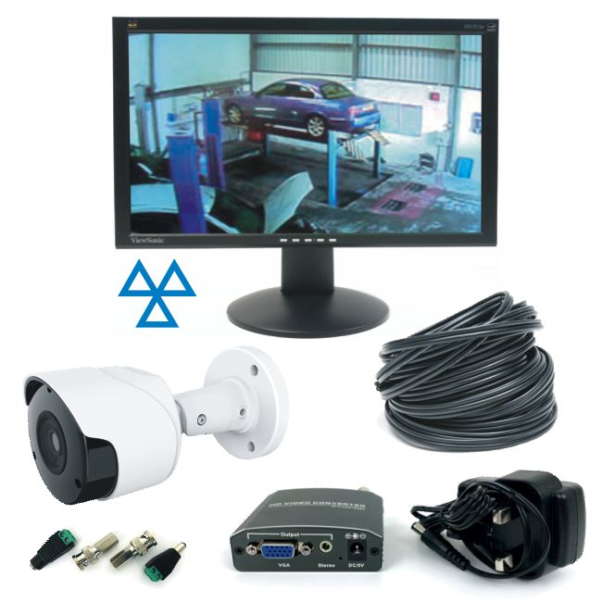

Slide 8
Embedded System SETUP
Raspberry Pi: Choose a Raspberry Pi board (e.g., Raspberry Pi 4) as your embedded system. It's a versatile and widely used platform.
Camera Module: Attach a compatible camera module to the Raspberry Pi via the CSI port. The official Raspberry Pi Camera Module is a popular choice.
MicroSD Card: You'll need a microSD card with the Raspbian (or Raspberry Pi OS) operating system installed.
Power Supply: Power the Raspberry Pi with a suitable micro-USB power supply.

Slide 9



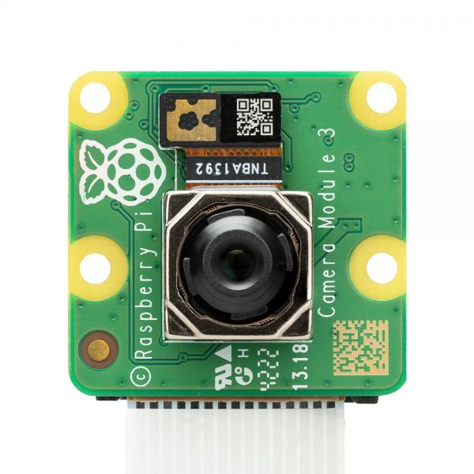
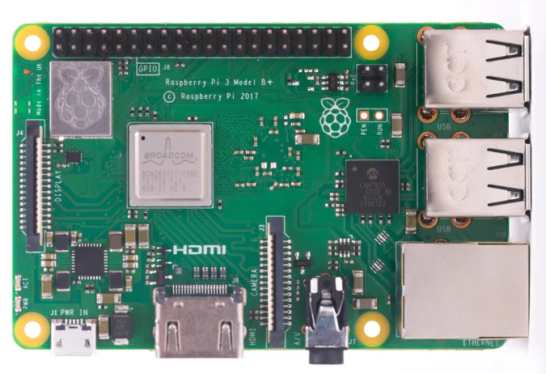
Power Supply:
Raspberry Pi
MicroSD Card:

Slide 10
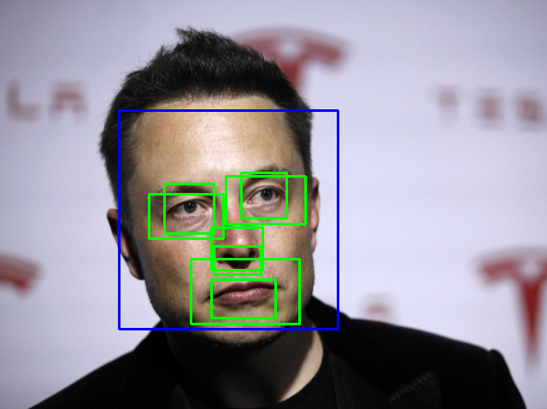
Face detection method
This the picture that you can see
on the screen of monitor

Slide 11
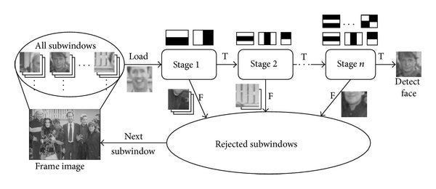
Faces Detection Using Haar Cascade
Step by step
stages

Slide 12
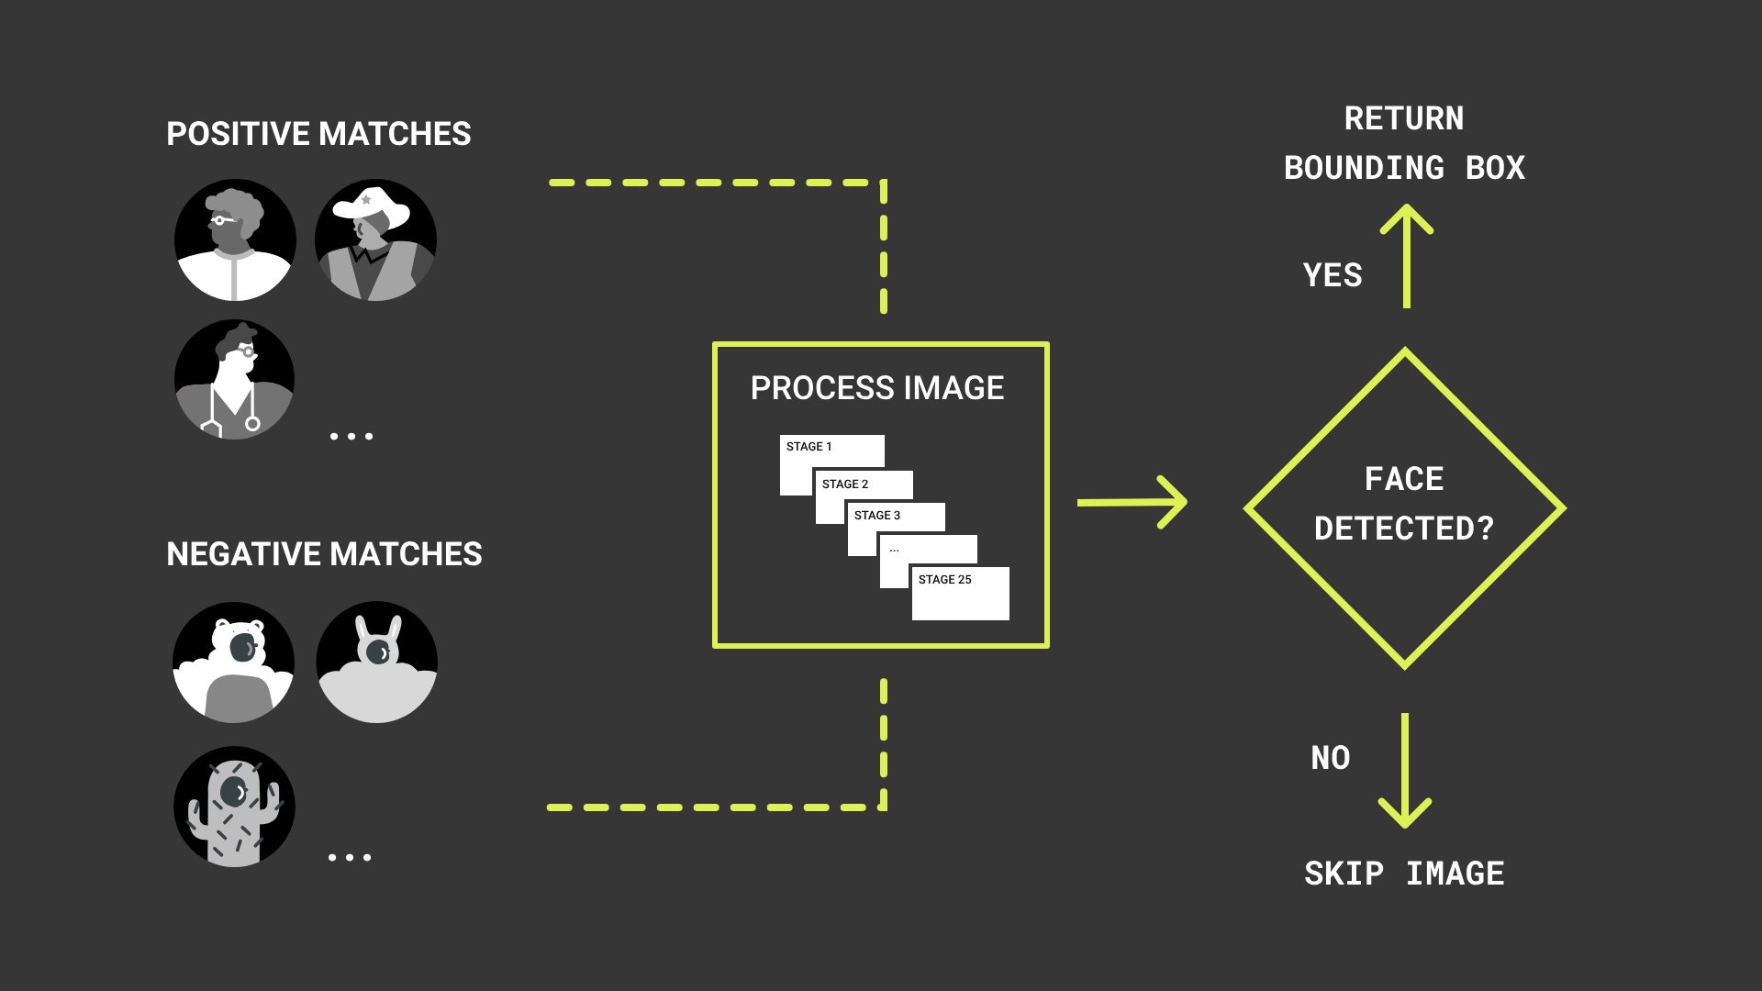

Slide 13
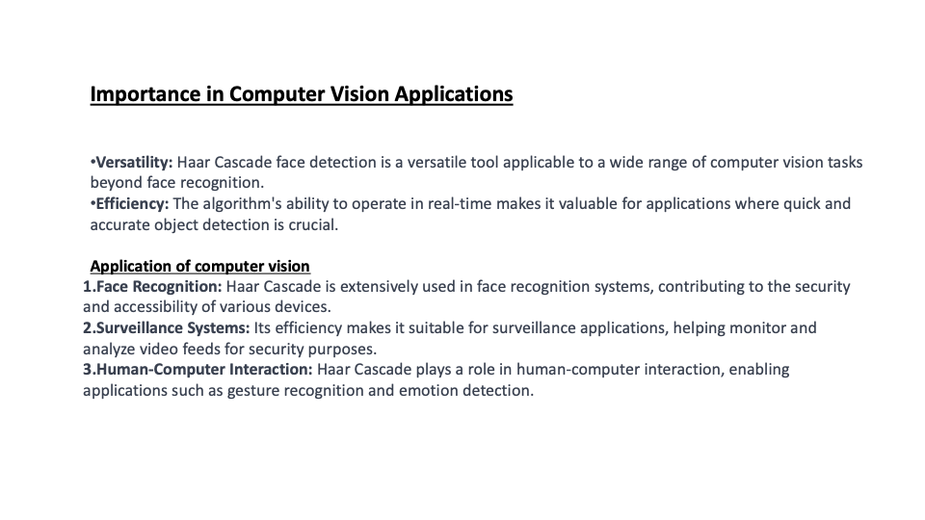
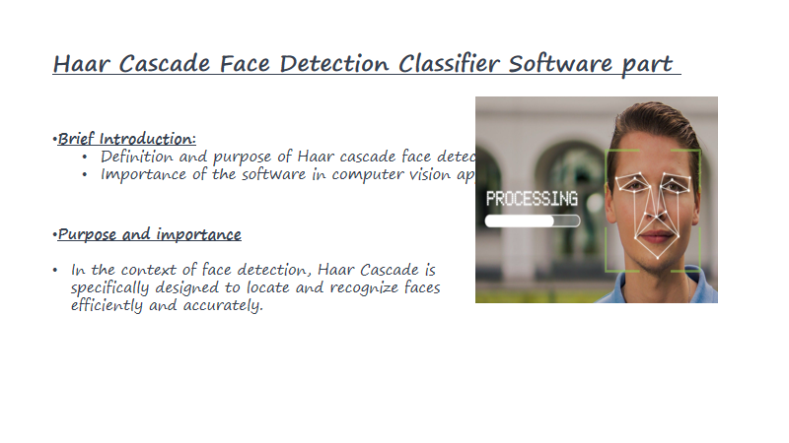

Slide 15
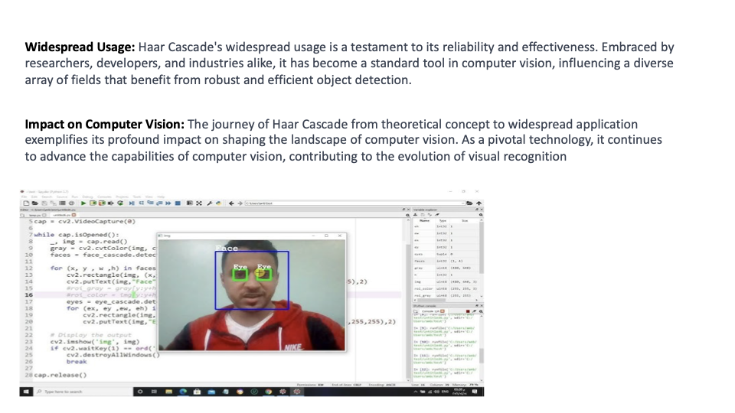

Slide 16
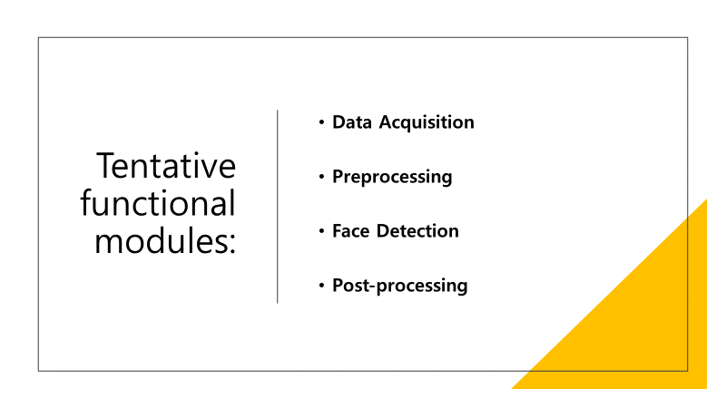

Slide 17
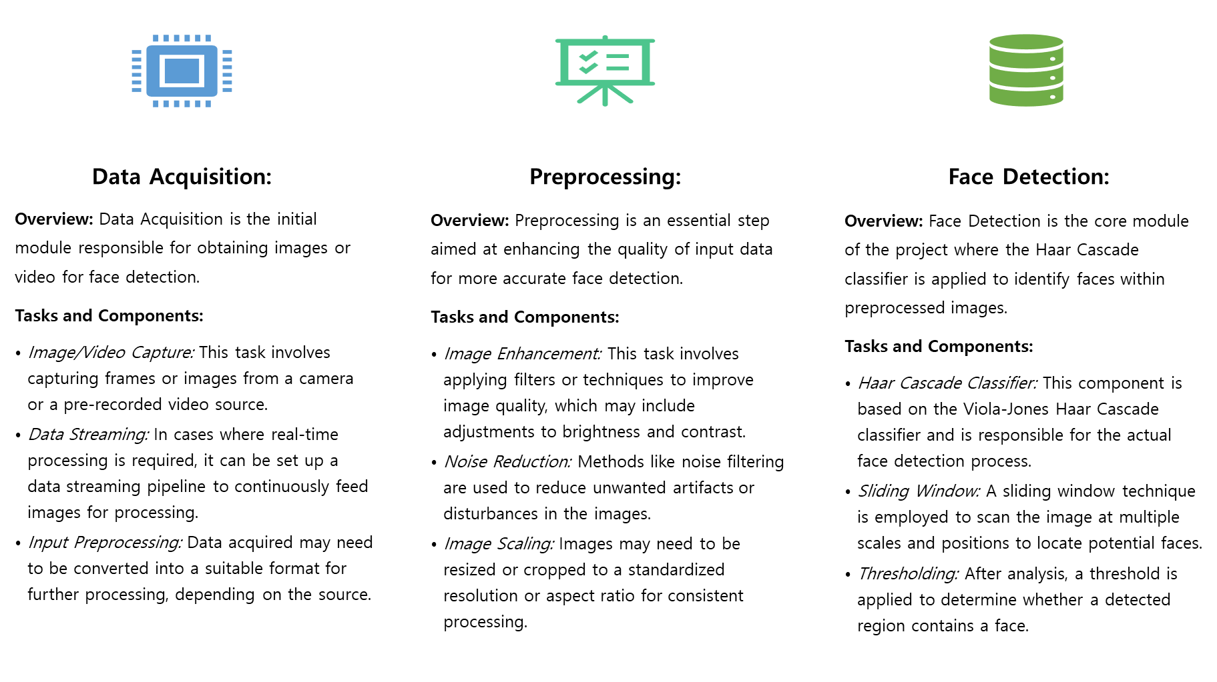

Slide 18
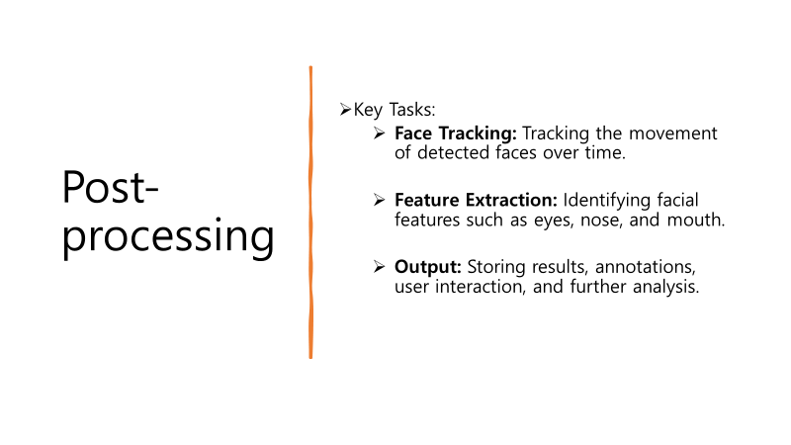

Slide 19
Roles and Responsibilities

Slide 20
Team Leader
Design Specialist
Software Developer
Test Analyst
Hardware
Quality Assurance
Raykhonov Tilov 12225275
Tariel Bekzhanov 12225274
Mohammed Alhammadi 12200182
Kudratkhon Sobitkhanov 12225273
Azhikeev Adilet 12214748
Azizbek Matyakubov 12214750

Slide 21
Further Proceedings

Slide 22
Data Augmentation: Expand your training dataset using techniques like rotation, scaling, and flipping. This helps the classifier generalize better to different poses and lighting conditions.
Real-time Detection: Implement real-time face detection by optimizing the the camera system and its frequency.
Multi-face Detection: Enhance the classifier to detect multiple faces in a single image.
Addressing Imbalance: If your dataset has class imbalances (e.g., more non-face images than face images), employ techniques like oversampling or undersampling to balance the classes.
User Feedback: Gather feedback from users and stakeholders to understand real-world performance and identify areas for improvement.

Slide 23
THANK YOU

